Slide 1

GOOGLE PHOTOS · PRODUCT CASE STUDY
From 10M to 100M users
Making every memory one tap away — reinventing search so photos find you.
THE MISSION
Scope: 10M active users today → 100M users
Goal: retain the existing 10M while adding new ones

Slide 2
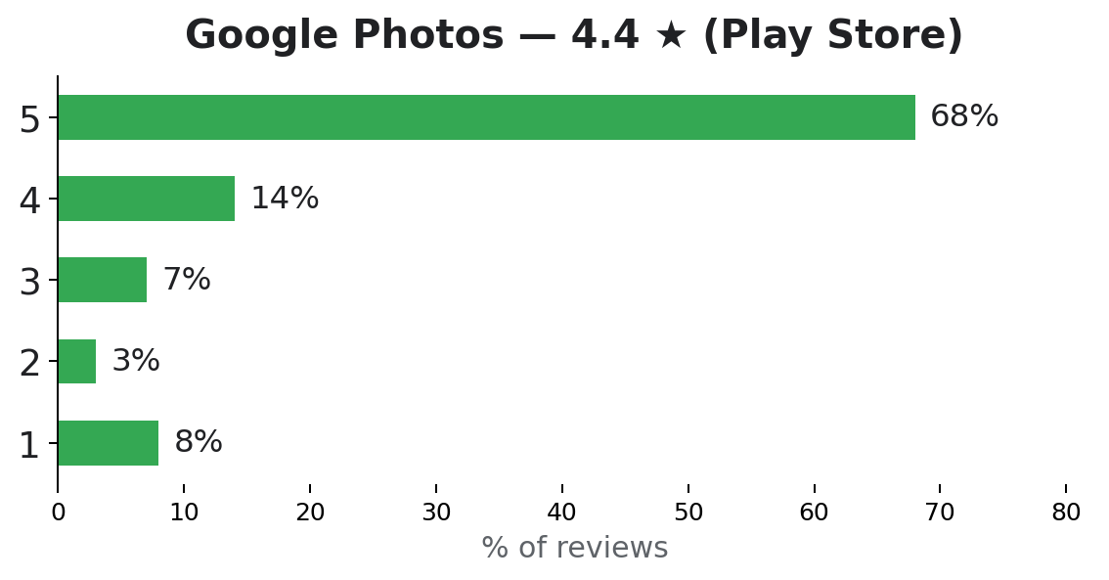
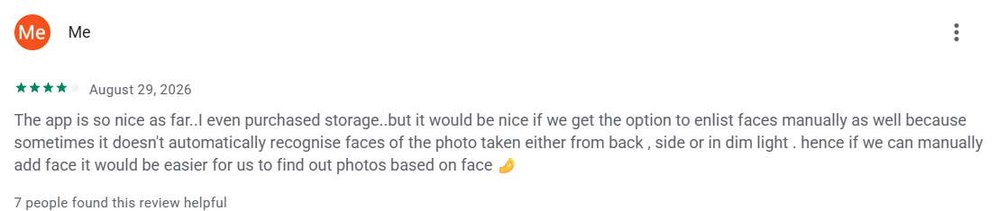
RESEARCH · APP-STORE EVIDENCE
2
What users are telling us
A real review: face-recognition gap
Common themes across reviews
• Face recognition misses — users want manual face tagging
• Search returns literal matches, not what they meant
• Duplicates and multi-device libraries feel chaotic
4.4★ looks healthy — but the long tail of 1–2★ reviews tells the real story.
Google Photos · Scaling search to 100M users
2 / 10

Slide 3
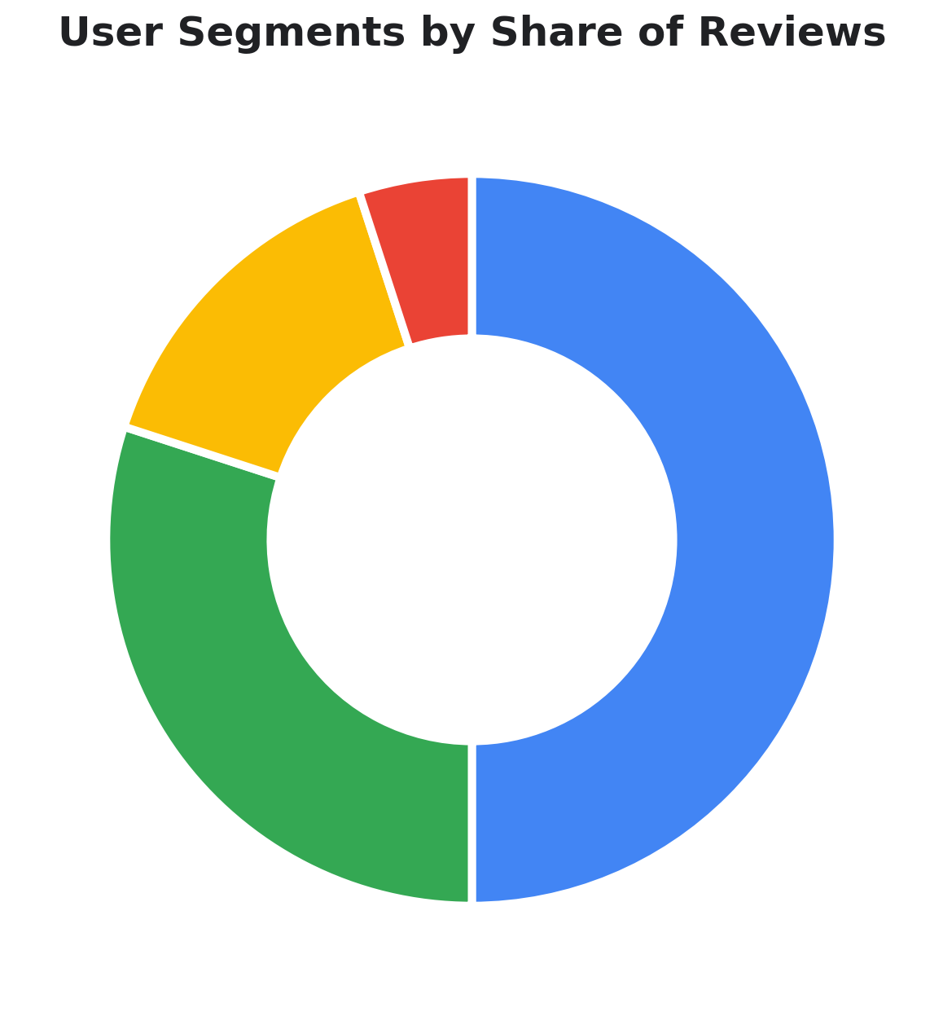
RESEARCH · WHO WE DESIGN FOR
3
Segmentation through reviews
Event Archivists — 50% ★ TARGET
Parents & families. Capture huge volumes around birthdays, weddings, school functions.
Social Snappers — 30%
Young adults sharing everyday moments.
Memory Builders — 15%
Travelers & hobbyists curating collections.
Overwhelmed Collectors — 5%
Large libraries scattered across devices.
Google Photos · Scaling search to 100M users
3 / 10

Slide 4
RESEARCH · HOW MEMORY WORKS
4
What users remember — and forget
✅ They remember
❌ They forget
Emotional context: “the day we laughed so much”
Visual cues: clothing, colors, objects
Social context: who was there
Exact timestamps: year, month, or day
File organization: album names, folders, devices
Location: unless it was a landmark
Hardest to retrieve: event-based photos · people-focused photos · everyday snapshots
So they search with approximations: “beach trip” instead of “Goa 2018” · “around 2015?” · “photos with Riya” · “birthday + cake + red dress”
Google Photos · Scaling search to 100M users
4 / 10

Slide 5
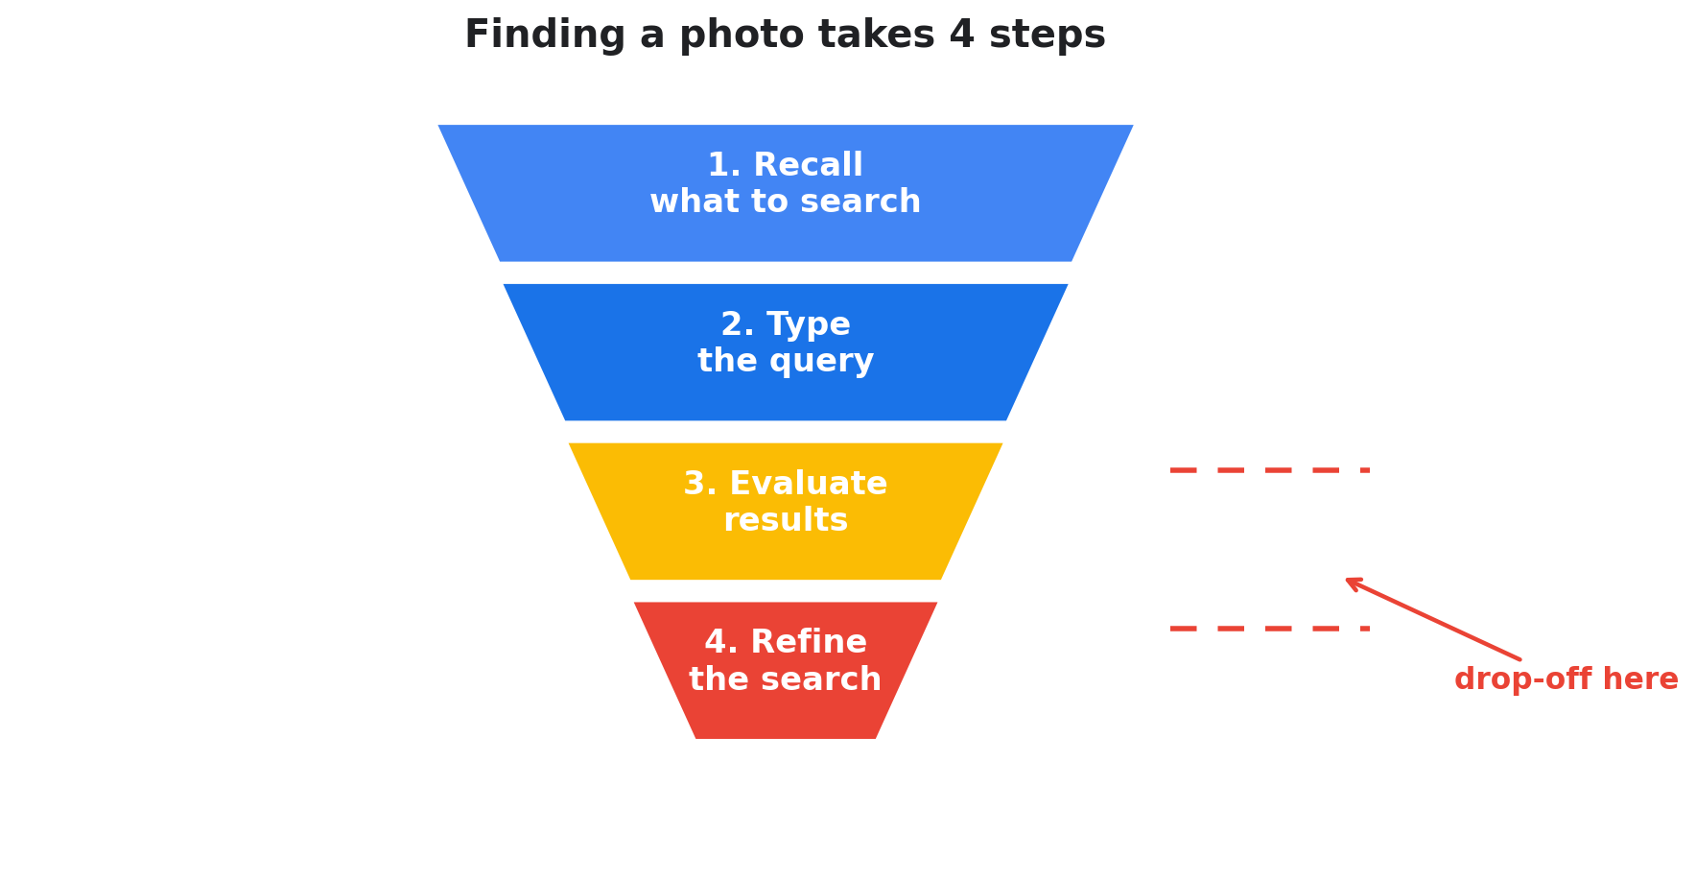
RESEARCH · THE RETRIEVAL JOURNEY
5
Finding a photo takes 4 steps
80%
of users find retrieval difficult
Steps 3–4
are where users drop off
~30%
use voice search; the rest type
4 → 1
steps is the competitive bar
Google Photos · Scaling search to 100M users
5 / 10

Slide 6
RESEARCH · EMPLOYEE STUDY
6
Four breakdowns in retrieval
1
2
3
4
Can’t express what they remember
Photos misses their clues
Results are hard to evaluate
Can’t refine a failed search
Behavior: Recall fragments (a person, clothing, “summer trip”) but can’t form search terms.
Outcome: Retrieval fails before it begins.
Opportunity: Conversational search (“describe what you remember”) + voice/multimodal input.
Behavior: “Beach trip” matches literal metadata only, missing semantic context.
Outcome: Relevant photos are excluded.
Opportunity: Semantic search, fuzzy matching, contextual inference.
Behavior: Dozens of thumbnails with little context.
Outcome: Retrieval feels overwhelming.
Opportunity: Cluster by people/events, highlight remembered cues, richer previews.
Behavior: Don’t know how to adjust queries.
Outcome: They abandon the search or scroll endlessly.
Opportunity: Guided refinement (“try narrowing by year”), interactive filters, search trails.
Google Photos · Scaling search to 100M users
6 / 10

Slide 7

DEFINE · PROBLEM STATEMENT
7
Retrieval fails at the memory gap
“Retrieval fails because rigid metadata can’t match vague recollection.”
Target segment
Event Archivists — parents & families. They remember the occasion but forget the date, album, or device.
Root causes
• Memory fragments don’t become precise queries
• Literal matching misses semantic context
• Results are overwhelming and hard to evaluate
• No guidance to refine unsuccessful searches
A parent wants one birthday photo — child in a red dress. They remember “birthday + my child + red dress”, not the year, album, or device. Search returns unrelated photos.
Google Photos · Scaling search to 100M users
7 / 10

Slide 8
DEFINE · VALUE & BUSINESS CASE
8
Why solving it matters
🔄 Today’s workarounds
❤️ User value
📈 Business sense
• Endless scrolling through timelines
• Guessing dates and retrying
• Cross-checking WhatsApp and iCloud
• Asking family members to recall details
• Less frustration and wasted time
• Relive emotional memories more easily
• Confidence Photos “thinks like memory”
• Stronger emotional product connection
• Effortless retrieval → engagement & retention
• Differentiates with memory-aware search
• Reinforces Google’s AI leadership
• Monetization: premium features, storage upgrades
Google Photos · Scaling search to 100M users
8 / 10

Slide 9
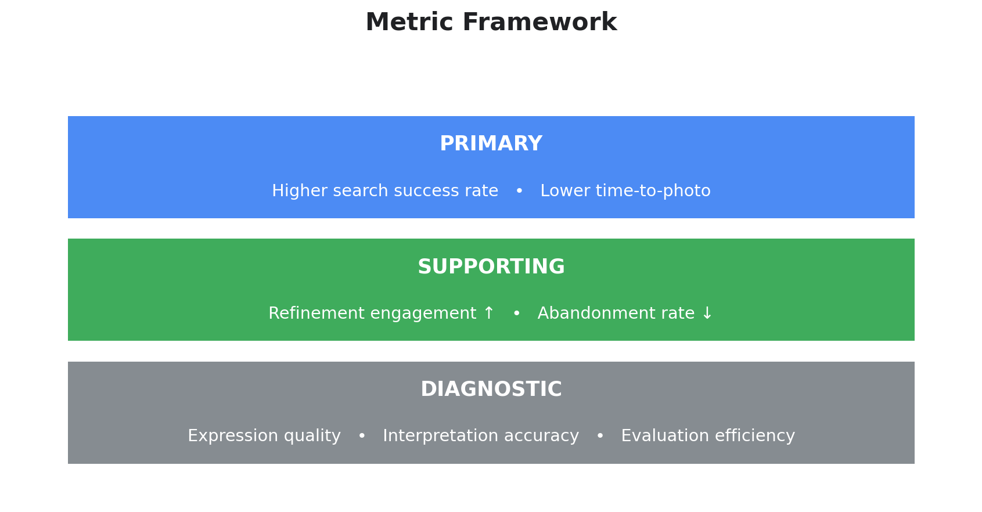

MEASURE · SUCCESS FRAMEWORK
9
How we’ll know it worked
North-star targets
Search success rate up
Time-to-photo down
Abandonment down, refinement engagement up
Move the primary metrics first; use diagnostics to pinpoint exactly where failures occur.
Google Photos · Scaling search to 100M users
9 / 10

Slide 10
PLAN · RISKS
10
Key risks & mitigation plans
1 · Expression risk
2 · Interpretation risk
Risk: Users still struggle to articulate vague memories, even with voice or natural language.
Mitigation: Guided prompts — “Do you remember who was there?” “Was it indoors or outdoors?” — scaffold fragments into usable queries.
Risk: AI misreads vague clues and returns irrelevant clusters (“red dress” → all red objects).
Mitigation: Multi-signal fusion — combine people, event, time, and object recognition — plus interactive confirm/refine.
3 · Evaluation risk
4 · Refinement risk
Risk: Too many results overwhelm users; they can’t spot the right photo.
Mitigation: Smart clustering by event, person, and location; highlight remembered cues (“photos with Riya in a red dress”).
Risk: Users abandon search after one failed attempt.
Mitigation: Guided suggestions (“try narrowing by year”, “add a person filter”) and visible search trails of past attempts.
Google Photos · Scaling search to 100M users
10 / 10

